Slide 1
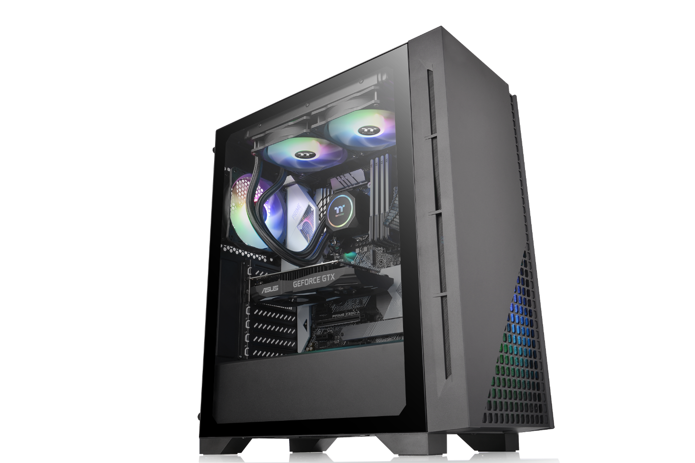
Thermaltake H330 TG Middle tower
Style：Simple
Size： Middle tower support up to ATX MB
Material： Steel & Plastic & Tempered Glass
Main Feature
Connection ： Top-Front I/O ports with 1 x USB 3.0, 2 x USB 2.0
Ventilation ： 1 preinstalled 120mm fan
Support ：Advance Cable Management

Slide 2
Thermaltake H330 TG Middle tower
Specification
Model | H330 TG w/600W PSU
P/N | CA-3R8-60M1WU-00
Case Type | Middle tower
Chassis Dimension (H*W*D) | 419 x 210 x 480 mm (16.5 x 8.27 x 18.9 inch)
Net Weight(Case) | 6.12 kg / 13.49 lb
Side Panel | 4mm Tempered Glass x1(Left )
Color | Exterior & Interior : Black
Material | SPCC
Cooling System | Rear (exhaust) : 1 x 120 x 120 x 25 mm fan (1000rpm, 16 dBA)
Drive Bays -Accessible -Hidden | 2 x 3.5“ or 2.5” (HDD Rack); 2 x 2.5” (HDD Bracket)
Expansion Slots | 7
Motherboards | 6.7” x 6.7” (Mini ITX), 9.6” x 9.6” (Micro ATX), 12” x 9.6” (ATX)
I/O Port | 1 x USB 3.0, 2 x USB 2.0, 1 x HD Audio,
PSU | PS-TTP-0600NNFANU-1
Fan Support | Front: 3 x 120mm or 2 x 120mm or 1 x 120mm 2 x 140mm or 1 x 140mm 2 x 200mm or 1 x 200mm Top: 2 x 120mm or 1 x 120mm 2 x 140mm or 1 x 140mm Rear: 1 x 120mm,
Radiator Support | Front: 1 x 360mm or 1 x 240mm or 1 x 120mm 1x 280mm or 1 x 140mm Top: 1 x 240mm or 1 x 120mm Rear: 1 x 120mm
Clearance | CPU cooler height limitation: 150mm PSU length limitation: 160mm(With HDD Rack) 200mm(Without HDD Rack) VGA length limitation: 300mm RAM height limitation: 60mm(With radiator series)

Slide 3
Thermaltake H330 TG Middle tower
Packaging
Package Information | H330 TG w/600W PSU
EAN Code | 4713227526913
UPC Code | 841163076927
N.W | 6.12 kg / 13.49 lbs.
G.W | 7.29 kg / 16.07 lbs.
Carton Size (L x W x H) | 536 x 272 x 480 mm / 21.1 x 10.7 x 18.9 inch
Cuft | 2.47
Container | W/O pallet
20’ | 360
40’ | 810
40’ HQ | 950

Slide 4
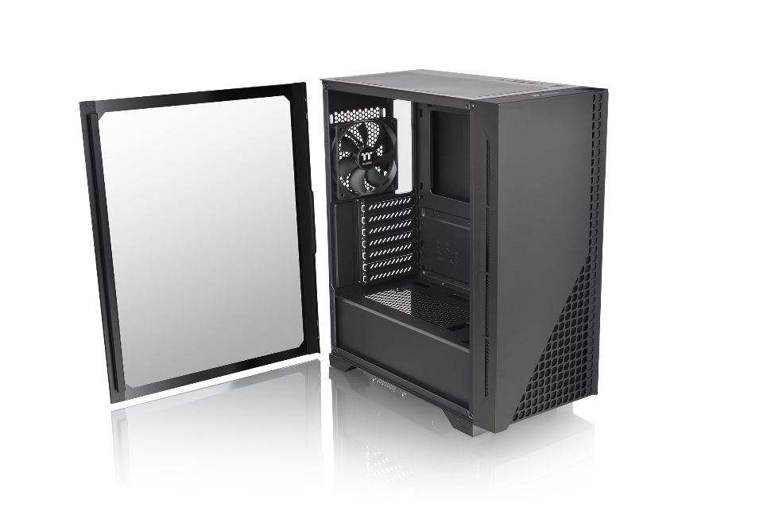
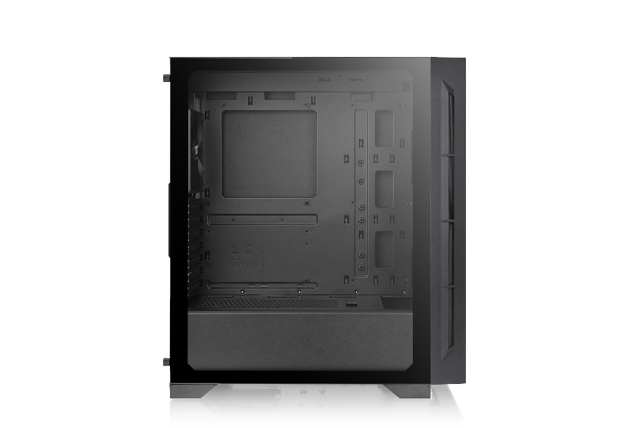
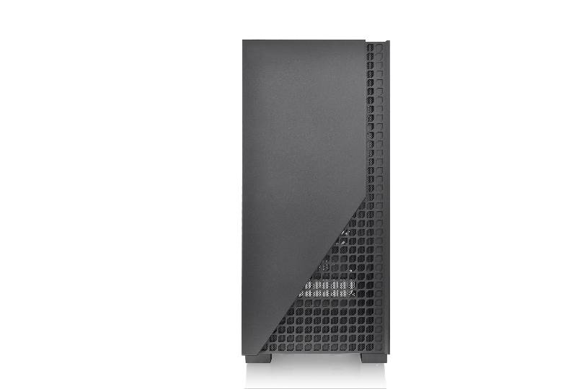
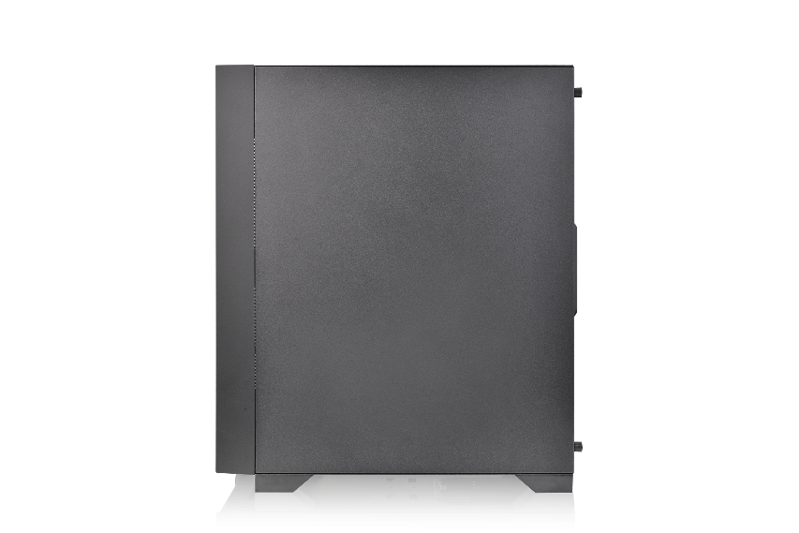
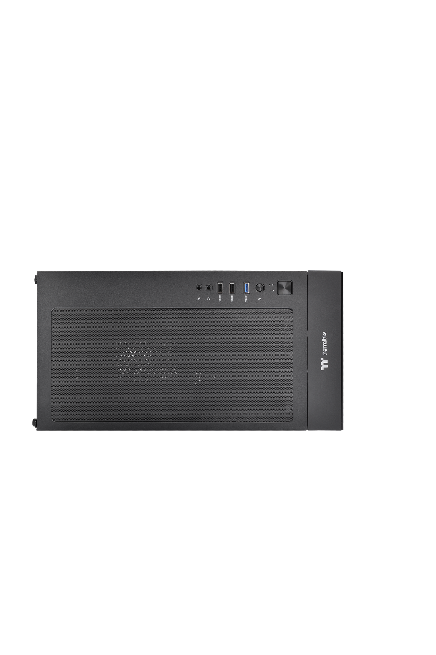
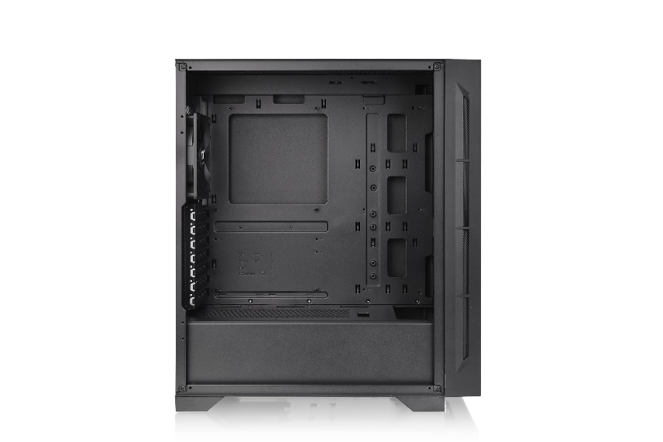
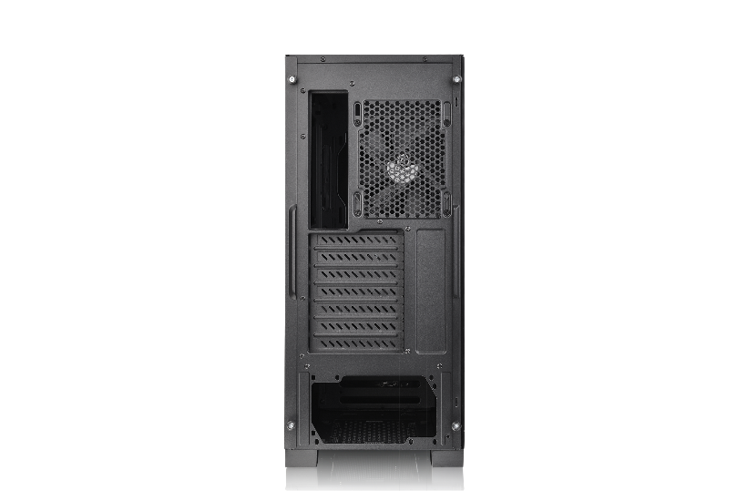
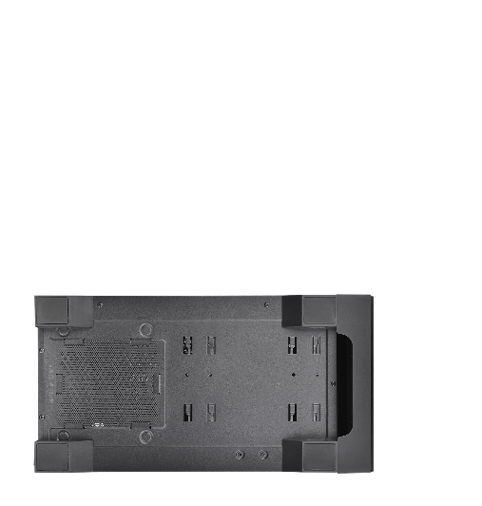
Thermaltake H330 TG Middle tower
Appearance - CA-1R8-00M1WN-00
Angle view
Left Side view
Front view
Right Side view
Top view
Internal Structure
Rear view
Bottom view

Slide 5
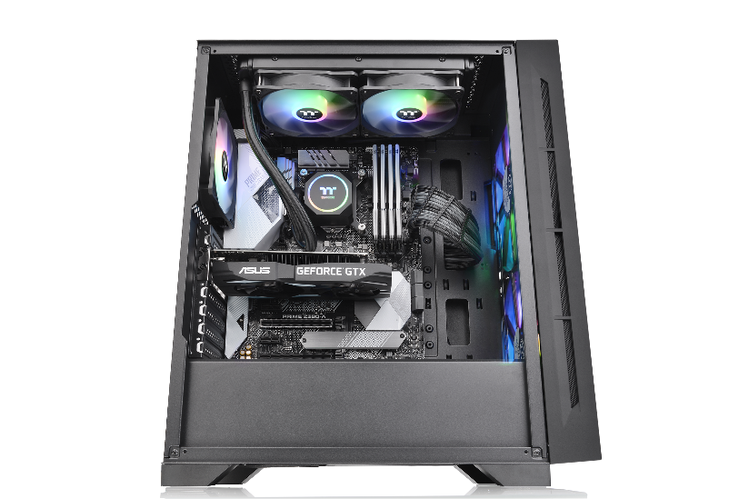
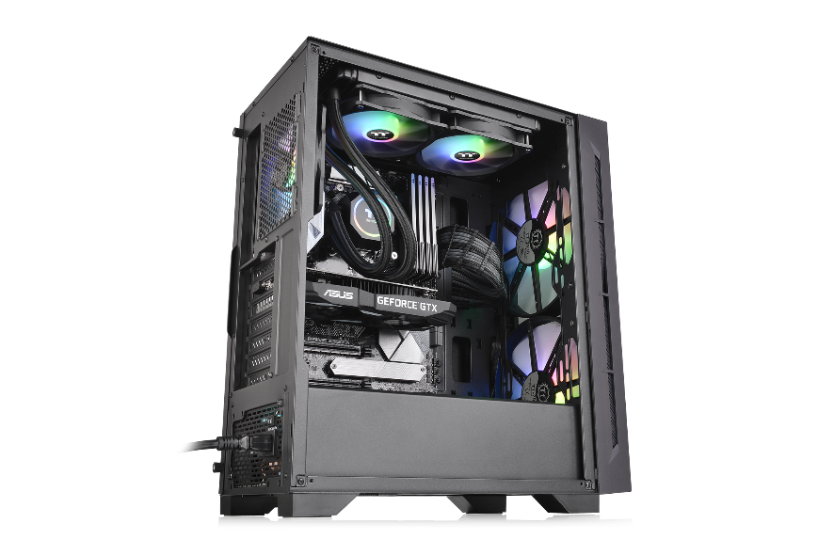
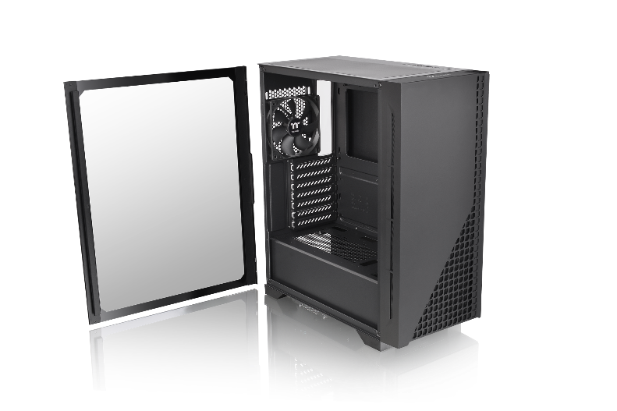
Thermaltake H330 TG Middle tower
Unique Design
Maximum support up to 6 x 120 mm fan
Maximum radiator support up to 360mm
1 x Tempered Glass

Slide 6
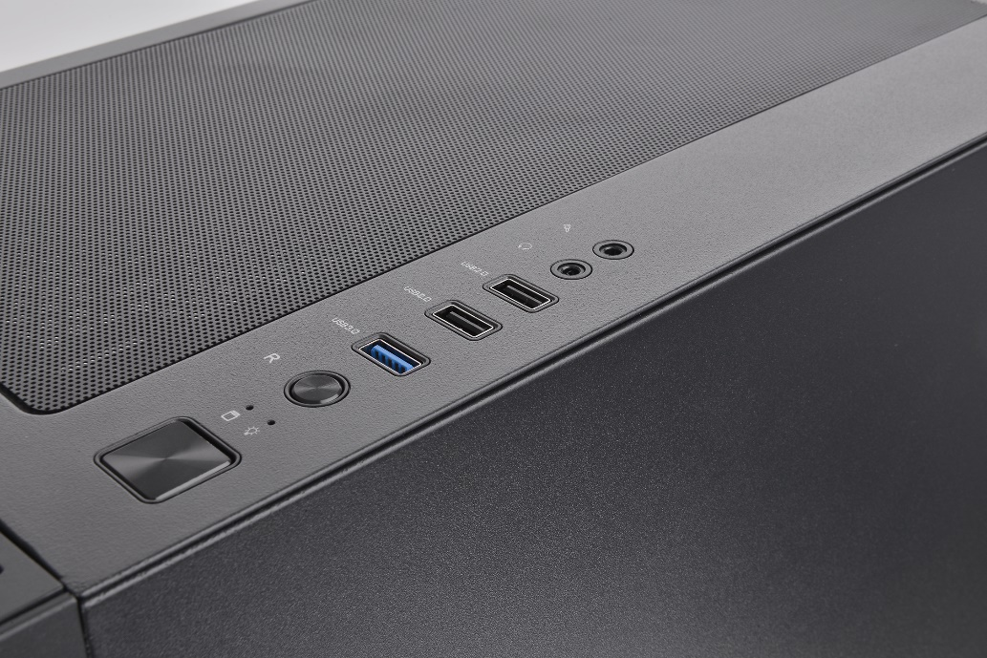
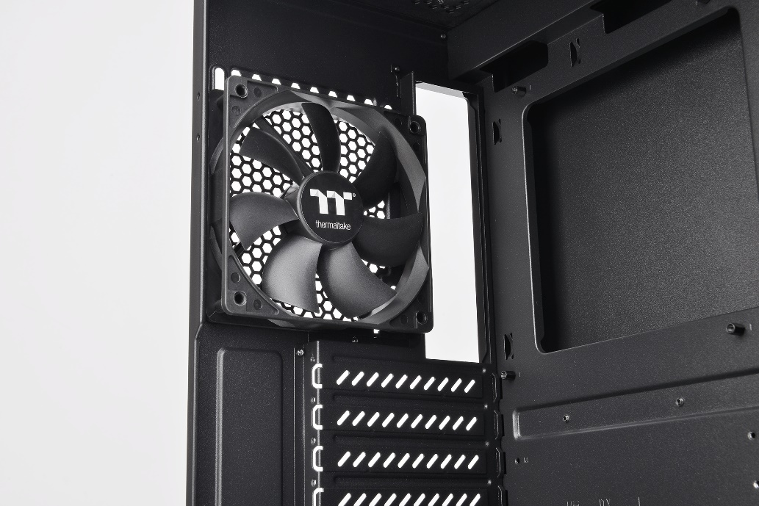
Thermaltake H330 TG Middle tower
Structure (External)
USB connector
One 120mm rear fan

Slide 7
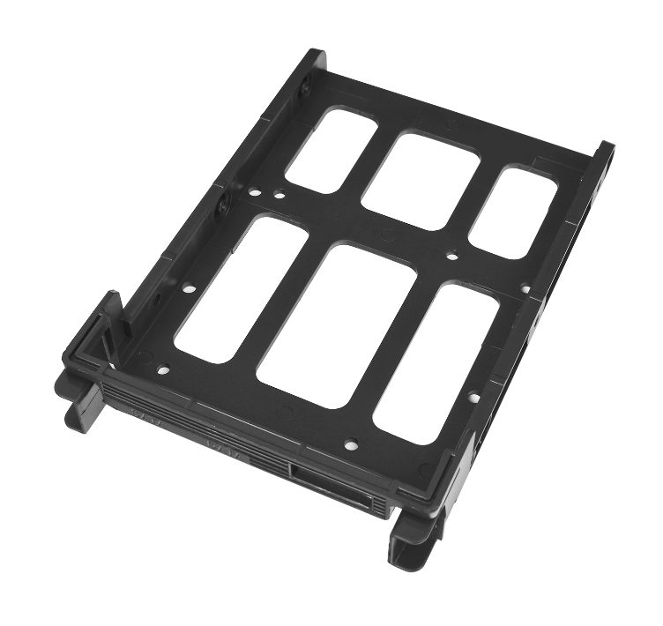
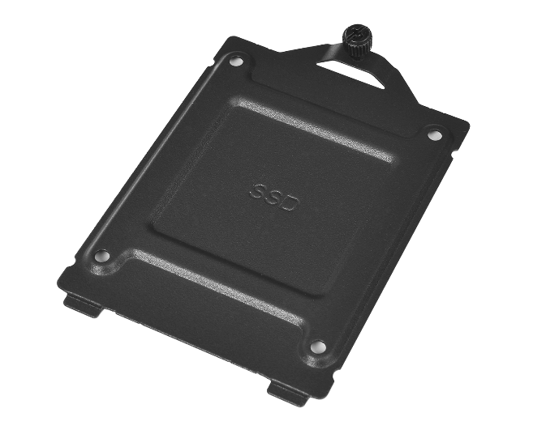
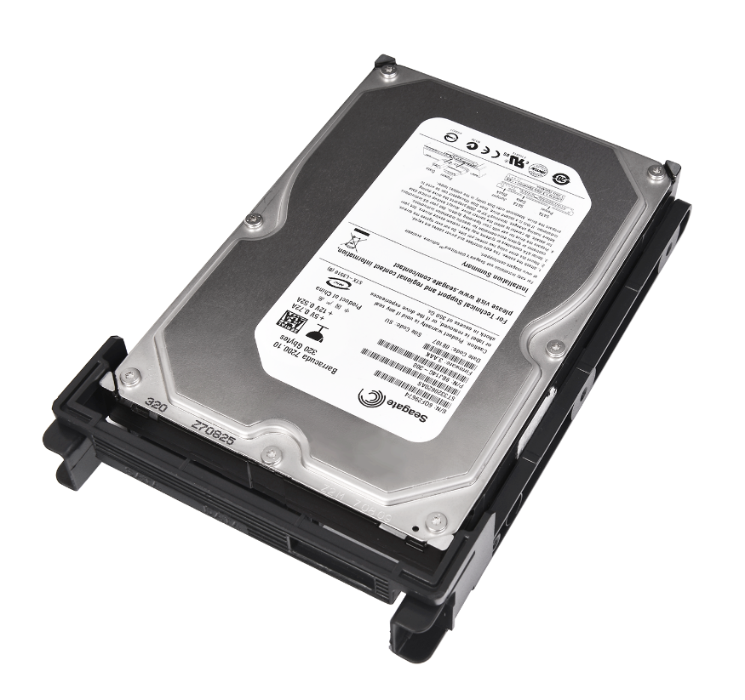
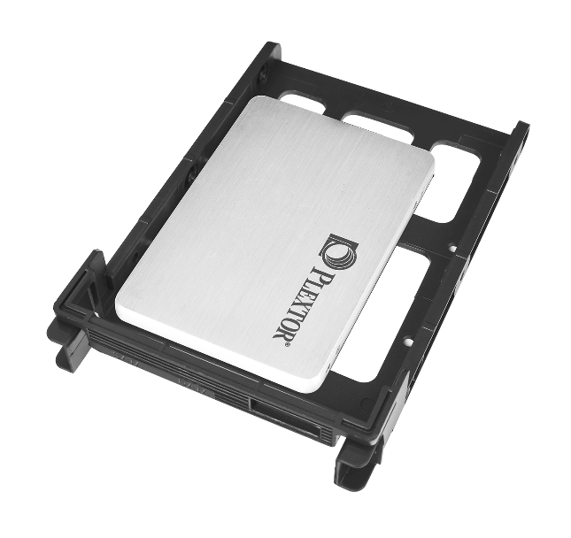
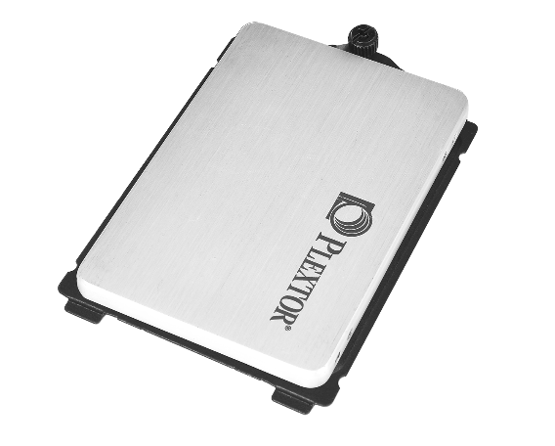
Thermaltake H330 TG Middle tower
HDD expansion introduction
HDD Bracket

Slide 8
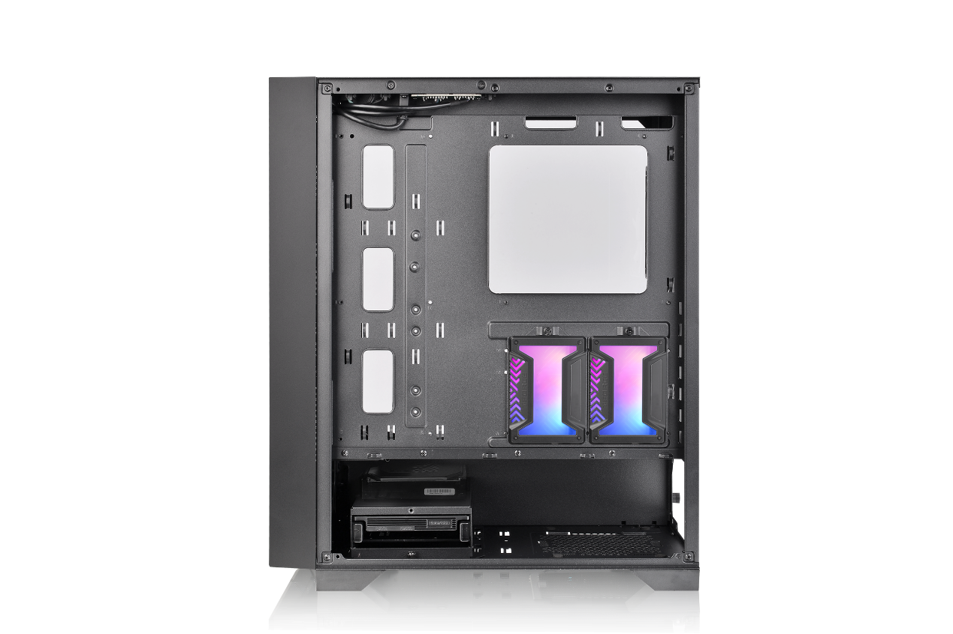
Thermaltake H330 TG Middle tower
HDD expansion introduction
Application

Slide 9
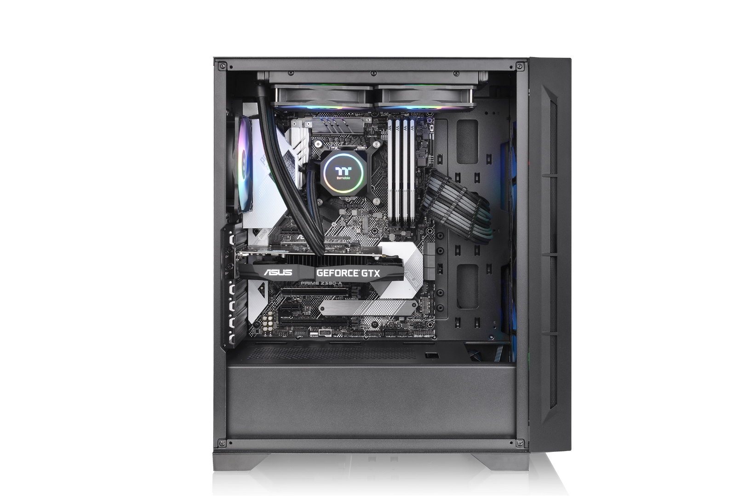
Thermaltake H330 TG Middle tower
The Cooling System – AIO Liquid Cooling (Optional)
A
B
A
CPU Air Cooling System
Rear (exhaust) : 120 x 120 x 25 mm ARGB fan x 1 (1000rpm, 16dBA)
B
HDD Air Cooling System
Front (intake) : 200 x 200 x 30 mm ARGB fan x 2 (800rpm, 29.2 dBA)

Slide 10
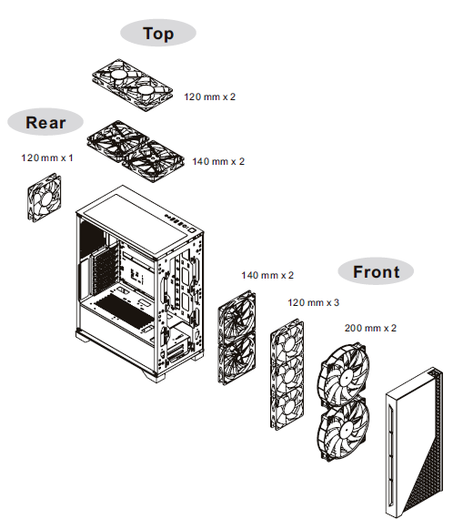
Thermaltake H330 TG Middle tower
Fan compatibility

Slide 11
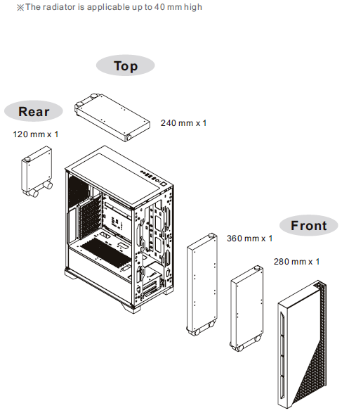
Thermaltake H330 TG Middle tower
Radiator compatibility

Slide 12
Thermaltake H330 TG Middle tower
Compatibility List
Fan Compatibility List
 | 120mm | 140mm | 200mm
Front | 3 | 2 | 2
Top | 2 | 2 | -
Rear | 1 | - | -
Thermaltake Compatible Fan
 | 120mm | 140mm | 200mm
PURE FAN Series | ● | ● | ●
Riing FAN Series | ● | ● | ●
Radiator Compatibility List
 | 120mm | 240mm | 360mm | 140mm | 280mm | 420mm
Front | ● | ● | ● | ● | ● | -
Top | ● | ● | - | - | - | -
Rear | ● | - | - | - | - | -
All-in-One Compatibility List (Water 3.0 and Floe series)
 | Performer | Pro | 240 Series | 360 Series | 140 Series | 280 Series
Front | ● | ● | ● | ● | ● | ●
Top | ● | ● | ● | - | - | -
Rear | ● | ● | - | - | - | -

